Slide 1
Strengthening the Innovation and Efficient Learning at Higher Education Institutions
Jelena Titko
EKONOMIKAS UN KULTŪRAS AUGSTSKOLA

Slide 2
ISPEHE INNOVATIVE COMPONENTS
STRATEGIC INTEGRATION OF LEARNING MODELS (SILM)
PILOT CONSOLIDATED CAREER CENTER
BUSINESS EDUCATION PROJECT PLATFORM (BEP)

Slide 3
STRATEGIC INTEGRATION OF LEARNING MODELS (SILM)
Main objectives:
Establishing educational best practices dedicated to the improvement of the current learning methods in the partnering institutions
Fostering innovation, creativity, business and leadership skills and supporting
Implementing models for effective and practical learning

Slide 4
SILM: NEEDS ASSESSMENT ANALYSIS
Objectives:
Identify the factual situation in each of the partnering HEIs
Provide assistance for making needed decisions related to establishing optimal learning models and best practices
Obtaining a participatory approach in constructing SILM from relevant stakeholders

Slide 5
SURVEY
The learning practices applied in partnering institutions,
The common teaching and assessment methods used in all 5 partnering institutions as well as the specific, unique and more creative ones,
The opinions of both, students and teaching staff, about such methods.

Slide 6
Problems at work with students
Language barrier
Do not understand the importance of the research
Do not know the terminology
Impartiality

Slide 7
EKA contribution to SILM
Design of the questionnaire
Report on survey results
Budanceva, J., Veidenberga, Z., Titko, J., Bierne, J. (2016). Business and Management Students Perception of Teching Methods // MRU conference 2016
Extended survey: Teaching methods for Competencies’ Development

Slide 8
Career center (CCC)
Research activities:
researching the existing career centers in partnering institutions, and other institutions throughout Europe and worldwide as well;
outlining the traits that successful career centers have, and then create a model for a unified career center, which will be applicable and useful in any higher education institution.

Slide 9
Career center (CCC)

Slide 10
Career center (CCC)
Conclusions:
The most important skills for newly-employed graduates are:
information seeking skills;
knowledge in using office equipment;
knowledge in using social media.
Most respondents agree with the statements:
Newly employed graduates have a developed code of ethics and understand the importance of conflict of interests
Graduates send a properly developed CV
Graduates send a properly developed motivational letter
It is important for graduates to possess certificates related to the field of business
It is important for graduates to have previous work experience, for example volunteering or internships

Slide 11
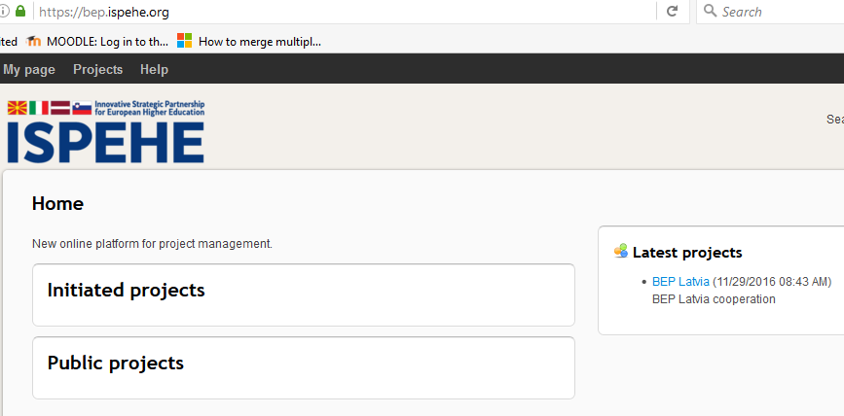
Business Education Public Integration Platform (BEP)
https://bep.ispehe.org
Goal: to bridge the gap between private, public and educational bodies.

Slide 12
Business Education Public Integration Platform (BEP)
MAIN TASKS:
Choosing the open source project management system which will be the foundation for BEP
Configuration of the frontend BEP system
Translation of the frontend in five languages
Quality assurance testing of the system (development of methodology, testing, report)
Delivering user manuals for the users of the system
Designing the screens for the frontend application

Slide 13
Thank you for collaboration!

