Slide 1

Greetings from Lithuania!
Dalia Mišeikienė
Digital Studies Unit
Mykolas Romeris University
Vilnius, Lithuania

Slide 2
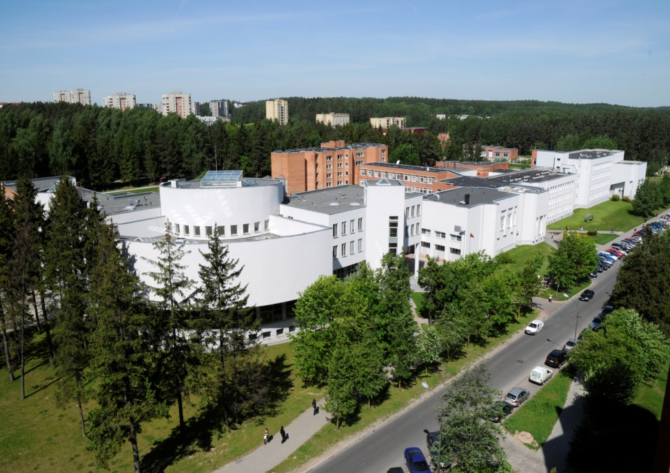
Mykolas Romeris University
Established in 1990 (former Law University of Lithuania)
Mykolas Romeris University is modern and dynamic European University
One of the largest Universities in Lithuania
Every year it attracts creative and talented people

Slide 3
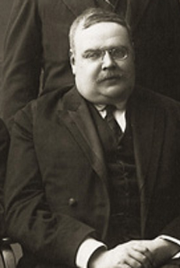
Mykolas Romeris (1880-1945)
In 2004 University was renamed to honor Mykolas Romeris
Mykolas Romeris – legal scholar, judge and father of Lithuanian‘s Constitutional Law

Slide 4
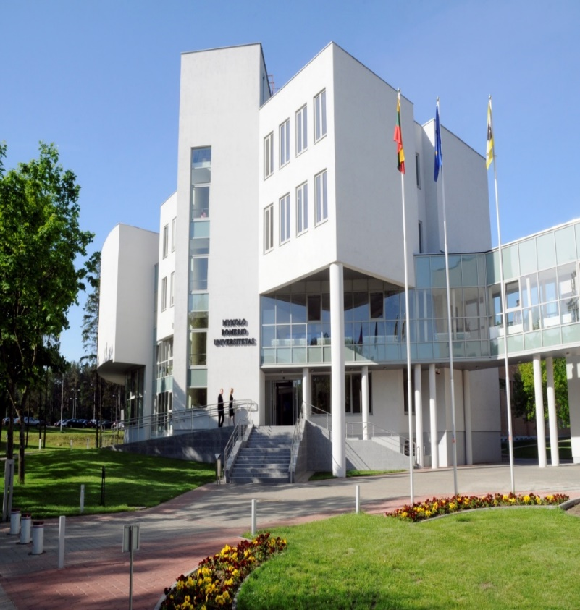
Some Facts about MRU
Number of Students at MRU: 8600
Including over 500 International Students
Full-time staff: ~ 600
Number of Study programmes: 110
Bachelor (3,5-4 y.), Master (1,5-2 y.),
MBA (1 y.) Doctoral (4 y.) degree studies
Focus areas: SOCIAL SCIENCES:
Law, Public Administration, Public
Security, Political Science, Economics,
Business and Management, Finances,
Informatics, Communication, Psychology,
Social Work, Sociology, Philology,
Education, etc.

Slide 5
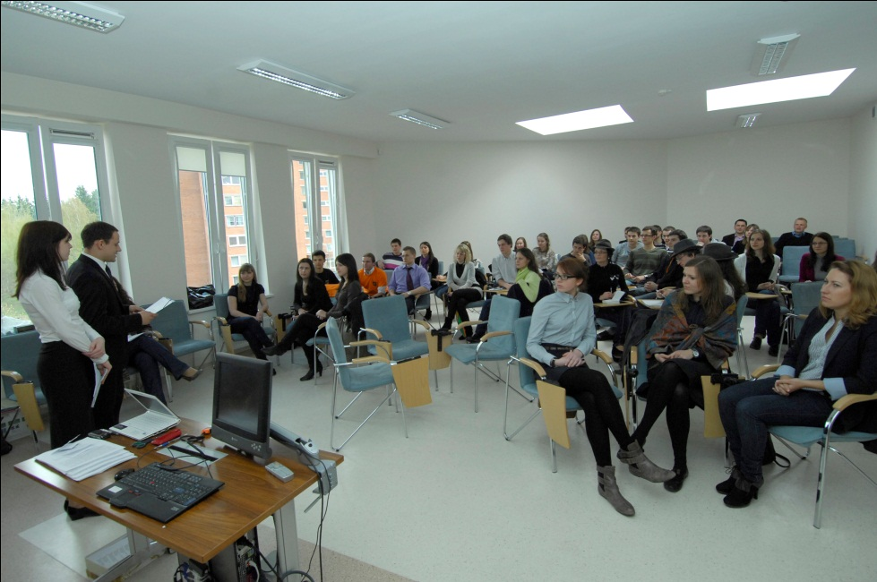
MRU Faculties and Institutes
Faculties
Faculty of Economics and Business
Faculty of Public Governance
Faculty of Law
Faculty of Public Security (in Kaunas)
Institutes
Institute of Communication
Institute of Educational Sciences and Social Work
Institute of Humanities
Institute of Psychology

Slide 6
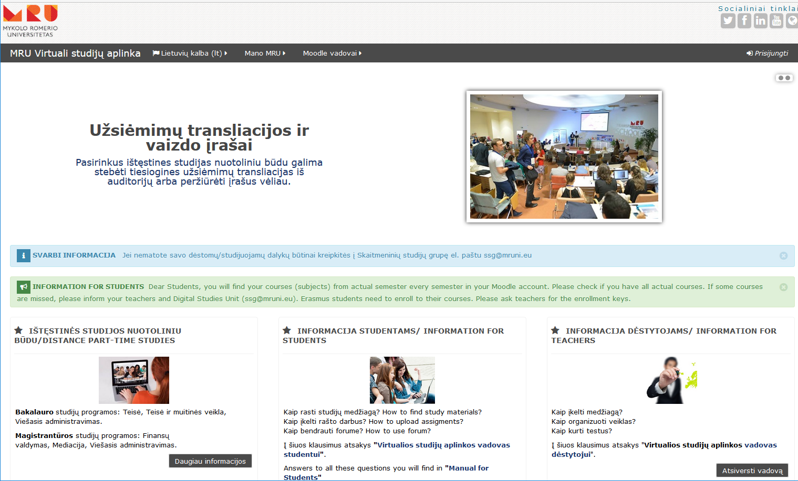
Moodle based Environment for Virtual Studies
Using Moodle platform in MRU since 2005

Slide 7
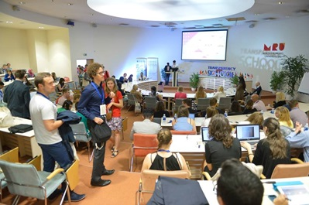
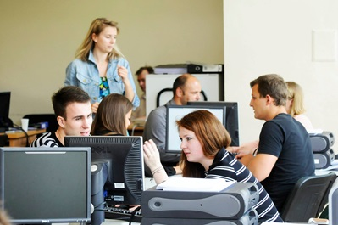
Virtual Studies
Some Facts in Numbers
Registered Moodle users –10300
All lecturers have over 4000 Moodle virtual courses
Distance learning (blended) - 3 Master and 4 Bachelor programmes
Students, studying remotely - 142
E-books – 200
Video records of lectures – more than 800
Distance examination with recording provided by Digital Studies employee – about 30 per academic year

Slide 8
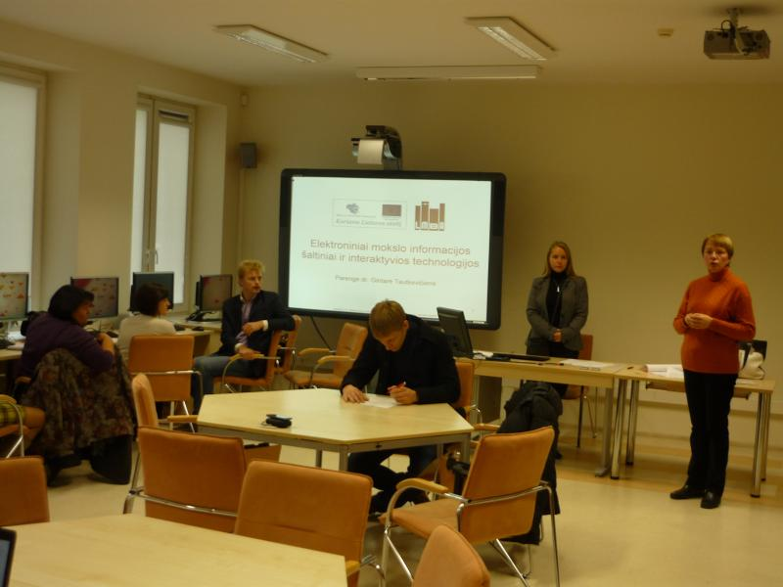
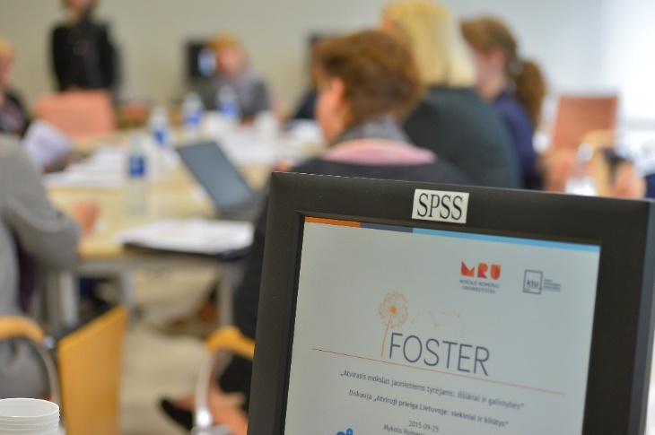
Conferencing Technologies
BigBlueButton Video conferencing, integrated with Moodle
Skype for Business
Video bridges with other institutions and countries using Cisco TelePresence MCU

Slide 9
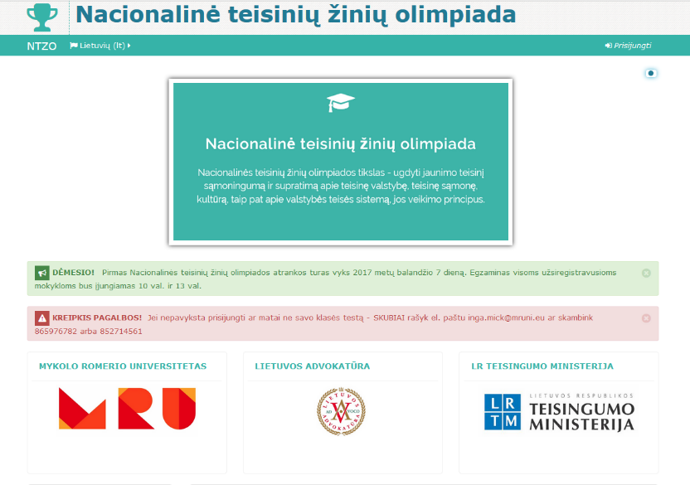
National Olympiad of Law for schoolchildren
Digital Studies Unit provides the 1st tour of Olympiad in Moodle since 2016
About 800 schoolchildren participated remotely from more than 70 schools of Lithuania

Slide 10




Contact us
Digital Studies Unit
daliam@mruni.eu
ssg@mruni.eu
MRU website
www.mruni.eu/en
www.mruni.eu/
https://www.facebook.com/MykoloRomerioUniversitetas
https://www.facebook.com/MRUErasmus/
MRU twitter
https://twitter.com/mrult

