Slide 1


CORPORATE PRESENTATION
ESIC
S P A I N & B R A Z I L

Slide 2














CORPORATE PRESENTATION • ESIC
+50 YEARS OF EXPERIENCE IN BUSINESS AND MARKETING
LINK WITH THE BUSINESS WORLD AND MARKETING
+44.000 FORMER STUDENTS
AGREEMENTS WITH +2,000 COMPANIES
9 CAMPUSES IN SPAIN - 2 CAMPUSES IN BRAZIL
HOY ES MARKETING [HEM] ANNUAL MEETING OF
MARKETING PROFESSIONALS
5 AREAS OF ACTIVITY: UNDERGRAD / GRADUATE / EXECUTIVE /
PUBLISHING / LANGUAGES
GLOBAL MARKETING COMPETITION [GMKC] BUSINESS COMPETITIONS
+90 UNIVERSITIES WORLDWIDE WITH WHOM WE MAINTAIN RELATIONSHIPS CONNECTED TO THE BUSINESS WORLD AND MARKETING
ASTER AWARDS RECOGNITION OF ACHIEVEMENTS OF PROFESSIONALS AND COMPANIES
PROMOTING ENTREPRENEURSHIP AND THE DIGITAL ECONOMY
+ESIC VOLUNTEERING + MICROCREDITS
ORBAYU FOUNDATION
OUTSTANDING POSITIONS IN THE RANKINGS IN THE BUSINESS SECTOR
MEET FORUM OF EMPLOYMENT ENTERPRISES AND ENTREPRENEURSHIP
HIGH QUALITY AND PROFESSIONAL TEACHING FACULTY

Slide 3
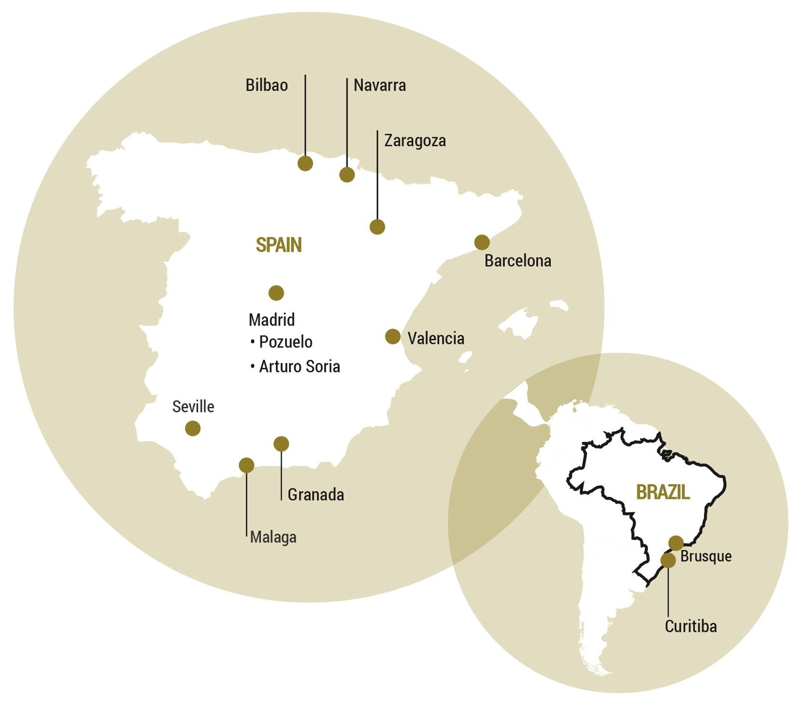
LOCATION OF OUR OFFICES
CORPORATE PRESENTATION • ESIC
We have schools in Madrid, Barcelona, Valencia, Seville, Zaragoza, Navarra, Malaga, Bilbao and Granada in Spain, and also in Brazil (Curitiba and Brusque).

Slide 4





5 AREAS OF SPECIALTY
CORPORATE PRESENTATION • ESIC
UNDERGRADUATE
POSTGRADUATE
EXECUTIVE
PUBLISHING
LANGUAGES
Undergraduate education is the first level of our academic offerings.
ESIC is the leader in business and marketing training and delivers programmes such as:
Customized training, custom programmes oriented to senior management where we respond and
support companies and executives who need to stay ahead for the success of their management training.
Research and dissemination of business-related content, promoting knowledge and increasing synergy
between the various components of our community.
We have a strong language department acting transversely with the other areas, for the mastery of a second language.
The new university students can begin to define the itinerary of their curriculum:
MBA’s.
Master’s degrees and
Master's specialised for functional areas of the company.
International Master's given 100% in English
Specialists in the disciplines of the digital economy.
Intensive courses, conversation, blended, In addition to being an official examination centre for Cambridge and TOEFL,
guaranteeing the quality of our methodology.
Official degrees
Dual degrees
University degree + international tour with dual degree (Europe and U.S.A.)
Solutions for the individual
Solutions for companies

Slide 5
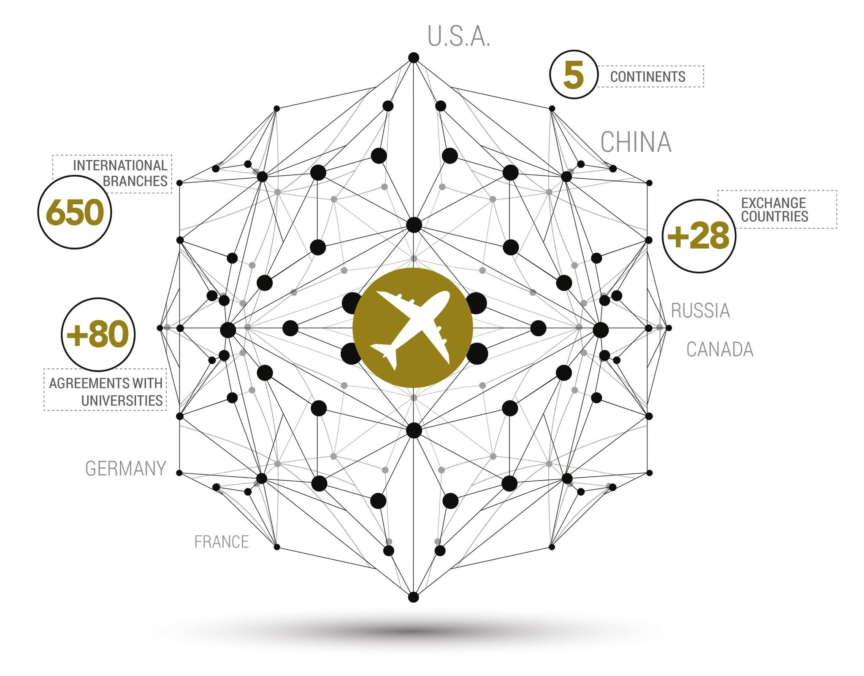




INTERNATIONAL DEVELOPMENT
CORPORATE PRESENTATION • ESIC
WE ARE BILINGUAL, MULTICULTURAL AND GLOBAL…
AND SO ARE OUR STUDENTS.

Slide 6





DEGREE AREAS
CORPORATE PRESENTATION • ESIC
Business • Marketing • Communication • Publicity • Digital
OFFICIAL DEGREES
Business Administration:
  Madrid: Offered in English & Spanish
  Valencia: Offered in Spanish
International Business:
  Valencia: Offered in English
Communication & Publicity:
  Madrid & Valencia
Digital Business:
  Madrid Bilingual English & Spanish
Marketing Management:
  Madrid, Valencia, Zaragoza and Barcelona
UNIVERSITY DEGREES
Marketing Management and Commercial Management: Madrid (Last year offered in English), Barcelona, Pamplona, Seville, Granada, Zaragoza and Malaga
Come to ESIC to study business or specialize in marketing with an international perspective
We offer our partner universities student exchange programmes (Erasmus+, Munde and other agreements) and dual degrees (graduate and postgraduate) on a range of programmes.
ESIC is affiliated with Spanish public universitys:
*Pening verification
www.esic.edu/grado

Slide 7

POSTGRADUATE DEGREES
CORPORATE PRESENTATION • ESIC
MBA´S
Master's in Business Administration (MBA)
Executive Master's in Business Administration (EMBA)
International Master's in Business Administration (IMBA) Dual degree
MÁSTER ESPECIALIZADOS
Master's in Marketing and Commercial Management (GESCO)
Master's in Business Administration and Marketing (MADEM)
Master's in Personnel Management and Organizational Development (DRHO)
Master's in International Commercial Management (MDCI)
Master's in Communications Management and Publicity (MPC)
Master's in Finance Management (MDF)
Master's in Marketing Management (MIM)
Máster en Marketing Science (MMS)
Master's in Logistics and Supply chain (LOCS)
Master’s in International Fashion Marketing and Luxury (MM&L)
Master’s in Management and Sports Marketing (MDMD)
MÁSTER UNIVERSITARIOS
University Master’s in Commercial Management (OGC) - URJC
University Master’s in Personnel Management and Organizational Development (MDPO) - URJC y UMH
University Master’s in Communications Management and New Technologies (DCNT) – URJC
University Master’s in Marketing and Digital Management (MMGD) – UMH
MÁSTER EN ECONOMÍA DIGITAL
Master's In Digital Business (MDB)
Master's In Digital Marketing (MMD)
Master's In Digital Customer Management (MICEMD)
Master's In Skills in the Digital Economy (on-line) (MOCED)
www.esic.edu/postgrado

Slide 8


INTERNATIONAL MASTER PROGRAMMES
CORPORATE PRESENTATION • ESIC
You will study, in whole or in part, in English, including a stay abroad. We provide an opportunity to function in a multicultural environment that promotes employability on an international level.
INTERNATIONAL MBA [IMBA]
Dual MBA Degree ESIC-SISU. Europe & China.
1st position in Employability and Shortest Payback Period in Europe.
MASTER IN MARKETING MANAGEMENT [MIM]
Two unique options to strengthen the participants´ professional development.
Level 7 Chartered Postgraduate Diploma from CIM.
International Business Experience in China.
MASTER IN INTERNATIONAL TRADE MANAGEMENT [MDCI]
Optional study tours & double degrees.
Awarded 1st Place in the Ranking for National Master´s degrees specialised in International Trade Management by “El Mundo” 2015.
Leading programme. Supported by its 93 editions.
MASTER IN DIGITAL MARKETING [MDM]
The world of online communications and marketing in a master.
The most advanced techniques and practices of the online marketing environment.
100% focused on digital disciplines.
www.esic.edu/postgrado

Slide 9

DIGITAL ECONOMY PROGRAMMES
CORPORATE PRESENTATION • ESIC
ICEMD, specialists in the disciplines of the digital ecosystem
The Institute of Digital Economy is the branch of ESIC Business & Marketing School for the study, analysis and incorporation of innovative disciplines in new digital business models and communications that have evolved and been introduced with great prospects for the present and future.
It is the only institution in Spain with European Degrees in Relational Marketing, Direct and Interactive and Contact Centre.
It has the largest supply of training programmes in the market and an educational model based on classrooms, online, combined, e-learning or in company.
MASTER'S EN ECONOMÍA DIGITAL
Master's in Digital Business (MDB)
Master's in Marketing Digital (MMD)
Master's in Digital Customer Management (MICEMD)
Master's in Skills in the Digital Economy (on-line) (MOCED)
www.icemd.com

Slide 10

EXECUTIVE EDUCATION PROGRAMMES
CORPORATE PRESENTATION • ESIC
SOLUTIONS BY KNOWLEDGE AREA
[
] [ ] [
] [Economy ] [
Other Functional Areas
]
Strategy &
Management
HR and Managerial Skills
Marketing And Sales
Digital
CLASSROOM • BLENDED • ONLINE
B2C
Solutions for businesses and institutions
Flexible and adaptable formats and methodologies for your professional and personal life.
Adaptation and customization of the sector, the company, reality and collective profile.
Work progress modular to the requirements of each training project.
Wide territorial range and variety of programmes.
Qualification programmes, retraining, development
and lifelong learning.
Senior faculty by functional areas and sectors.
OPEN PROGRAMMES
CUSTOM PROGRAMMES
Conferences.
Masterclass.
Intensive courses.
Specialized courses.
Advances programmes.
Corporate schools:
Commercial, marketing and digital.
Advanced corporate programmes and training
plans by functional area.
www.esic.edu/executive
And other customized solutions.

Slide 11




LANGUAGE AREA
CORPORATE PRESENTATION • ESIC
ESIC Languages is designed to provide an interesting, enjoyable and rewarding experience that achieves the professional, academic or personal goals of international communication.
The activities and courses offered are designed both for businesses and professionals as well as individuals and, of course, tailored to the specific needs of our students.
ESIC Languages is accredited for the implementation and evaluation of the main level of internationally recognized tests: TOEFL, TOEIC, Cambridge General English and Cambridge Business English Certificates (BEC).
It also offers training in other languages such as German, French, Chinese and Spanish for foreigners (accredited by the Cervantes Institute) and the following summer programs:
Valencia:
  International Marketing with Spanish Language and Culture
  International Marketing and Cross Cultutral Communication with Spanish Language and Culture Program
Seville:
  International Business CSR: Spain and European Union in a global context with Spanish Language & Culture
www.esic.edu/idiomas

Slide 12

PUBLISHING AREA
CORPORATE PRESENTATION • ESIC
Publishing ESIC is the projection of ESIC into the
world of publishing, dissemination of the
providing research and subjects of economics,
business and marketing.
Its publishing catalog, constantly renewed, has more than 450 active titles, whose authors are mainly academics and professionals, experts familiar with our business environment.
It has more than 40 years experience, publishing professional books on marketing, advertising, sales, human resources, management skills, finance, strategy, economics, mathematics and statistics, which combine the rigor, experience, research and amenity. Our lines of work are:
Professional books
Dissemination
Educational Research
Documentation notebooks
University Technical notes
Digital Content
Scientific and technical journals
www.esic.edu/editorial

Slide 13



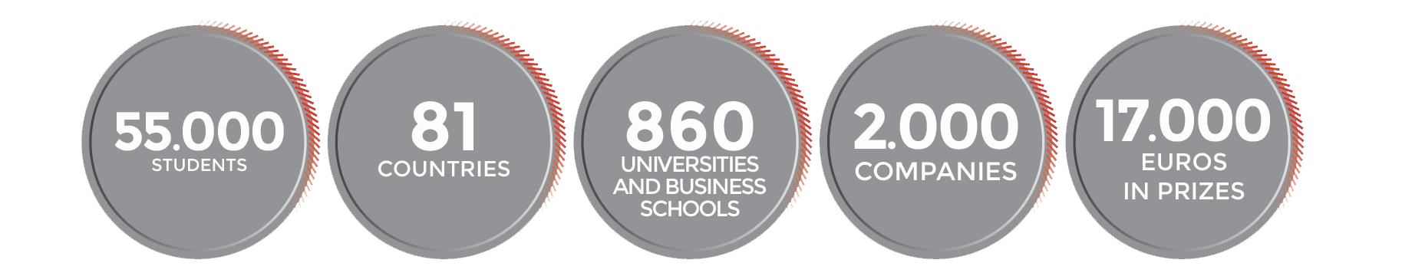
ESIC GLOBAL MARKETING COMPETITION
CORPORATE PRESENTATION • ESIC
ESIC has run this online marketing competition, aimed at university students, for the past 18 years, with 44.000 participants from 850 universities and business schools from 79 countries in all five continents. The competition is sponsored by Santander Bank and our educational partners are the EFMD, AACSB and CLADEA.
A REAL LIFE INTERNATIONAL GAMING EXPERIENCE
www.globalmarketingcompetition.com

Slide 14
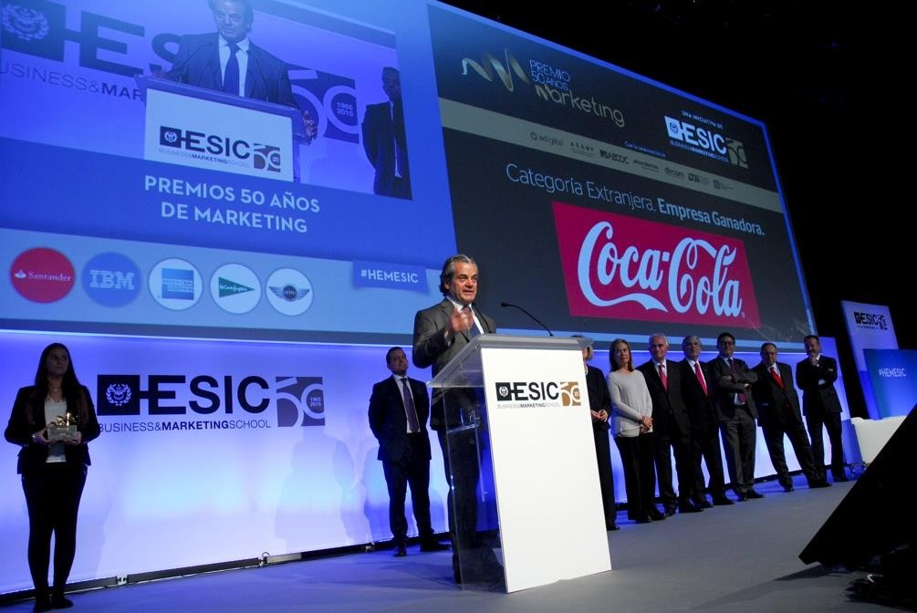

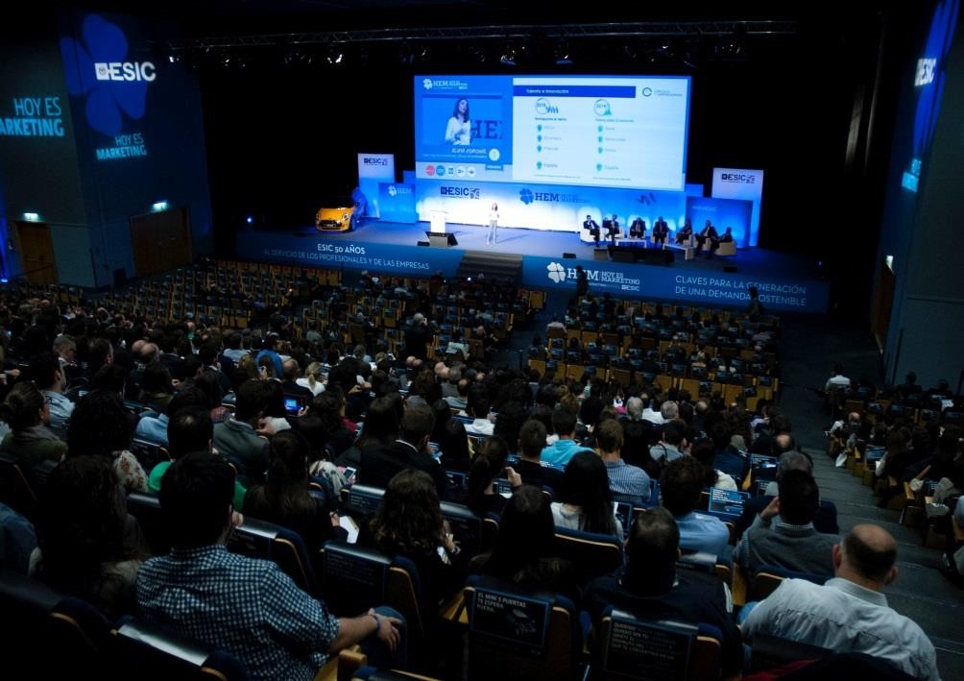
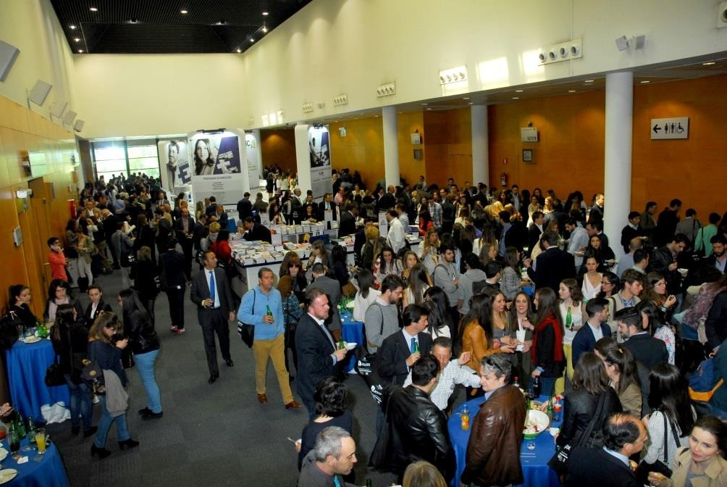
OTHER ITEMS OF DIFFERENTIATION
CORPORATE PRESENTATION • ESIC
Hoy es Marketing is the largest meeting place for professionals and executives from business, marketing, communications and the digital economy in Spain.
This is an annual event with editions in 3 large cities: Madrid, Barcelona and Valencia, organized by ESIC for 13 years.
For a whole day, in every venue, the most relevant industry experts disclosed successful strategies of large companies and define expectations and future business trends.
www.hoyesmarketing.com

Slide 15

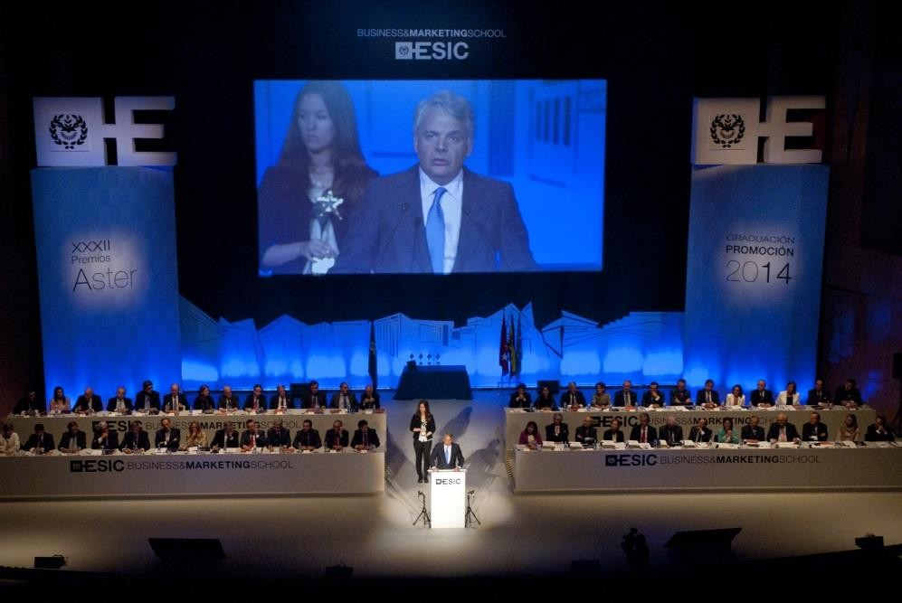
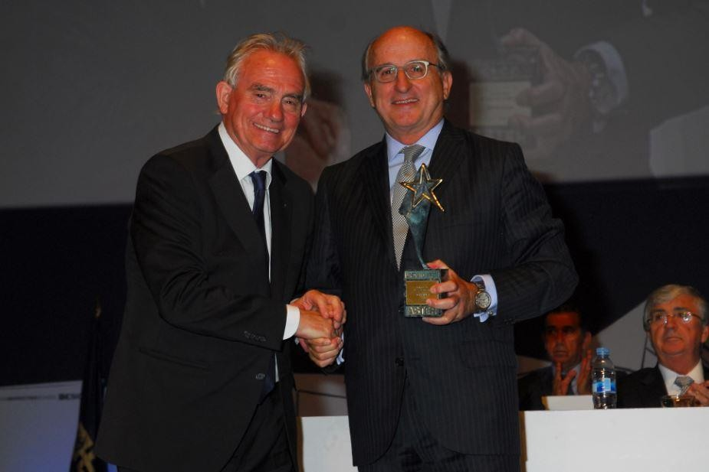
OTHER ITEMS OF DIFFERENTIATION
CORPORATE PRESENTATION • ESIC
Since 1982, ESIC has
organized
the Aster Awards,
awarded annually in recognition of the achievements of individuals, businesses and mass communication outstanding in their professional activity and in thier research in marketing, with the intention of enhancing integration between academic and business life.
A jury of business leaders, educators and politicians is responsible for evaluating the nominations in 6 categories: Business Development; Career Development; Best Entrepreneur; Marketing and Values; Research; and the Aster Communication Award.
www.esic.edu/aster

Slide 16






RATINGS & AWARDS
CORPORATE PRESENTATION • ESIC
ESIC has won awards from prestigious organizations on the national and international level, supporting the reputation of ESIC as an institution of quality training.
All roads come together in recognition of ESIC as an institution of reference in the field of training in undergraduate, graduate and executive education.
RELATED ASSOCIATED AND BUSINESS RESPONSIBILITY
ASSOCIATED UNIVERSITIES/BUSINESS SCHOOLS
ACCREDITATIONS AND CERTIFICATIONS

Slide 17
THANKS
DANKE • 謝謝 • MERCI • GRACIAS•

