Slide 1



Advanced Teaching Methods to Increase Students’ Engagement into Study Process
Jelena Titko
UNIVERSITY OF ECONOMICS AND CULTURE

Slide 2
EKA participation in Erasmus+ projects
Innovative Strategic Partnership for European Higher Education (ISPEHE). Jan 2015 – Dec 2016
Coordinator: Integrated Business Institute (R.Macedonia)
Partners: EKA, University of Ljubljana (Slovenia), Riga Technical university (Latvia), Pavia university (Italy)
Strategic Partnership for Innovation and Development of Entrepreneurship (SPIDE). Jan 2017 – Dec 2018
Coordinator: Integrated Business Institute (R.Macedonia)
Partners: EKA, University of Ljubljana (Slovenia), Hochschule für öffentliche Verwaltung Kehl (Germany)

Slide 3
ISPEHE goal
To support and implement models for effective and practical learning, through raising the awareness for an innovation driven culture: establishing educational best practices dedicated to the improvement of the current learning methods in the partnering institutions, fostering innovation, creativity, business and leadership skills;
To establish a foundation for promoting innovation and various career paths among prospective students;
To develop cutting-edge technology platform: designing an innovative solution dedicated to merging all stakeholders and creating various opportunities for sharing experiences, joint collaborative efforts and added value to all interested parties.

Slide 4
SPIDE goal
To increase practical learning and skills of the target group members, by supporting and integrating the Career Centers, that will merge efforts of skills build-up for increased understanding of entrepreneurship, market principles, competencies in business management and knowledge that will enable them to implement potential business ideas on the market.
To empower the target group members in the area of entrepreneurship and management by providing them with a simulated virtual environment, establishing a connection between practical and theoretical learning
To improve the quality and efficiency of educational best-practices at the partnering HEIs

Slide 5
Outcomes
ISPEHE:
Business Education Project Platform (BEP)
SPIDE:
Quest on business idea generation (EKA own contribution)
ICCE workshops for students
Business Simulation Software (BSS)

Slide 6
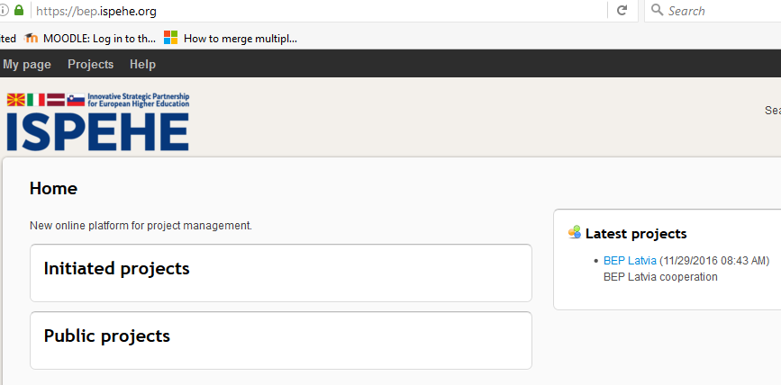
Business Education Public Integration Platform (BEP)
https://bep.ispehe.org
Goal: to bridge the gap between private, public and educational bodies.

Slide 7

BEP and COOL
COOL means Collaborative Online Learning:
    Students work in an international environment
    Students work on an international brand/product/service
    Students interact with peers from other countries
The idea is for students to get initiated in the world of international business and marketing
The BEP platform will provide an on-line solution for communication among students and project coordinators, as well as more advanced functions for the latter phases

Slide 8
BEP opportunities
Using the BEP platform to implement COOL, as a crucial integrated component of the project.
BEP will provide:
    Student profiles with personal information
    Uploads of CVs and video biographies
    Formation of student groups
    Forums for discussion
    Voting mechanism
    Video conferences

Slide 9
Quest “Business Idea Generation”
Gamification is described as “using game-based mechanics, aesthetics and game thinking to engage people, motivate action, and promote learning” (Kapp, 2012)
Implementation of quest-based learning and game mechanics at the university level demonstrates encouraging results:
Game-based feedback tools like experience points, progress bars, badges, and achievements are motivating and meaningful to students.
Students in a quest-based course received higher grades overall when compared to the quivalent traditional course.
An escape room is a physical adventure game in which players solve a series of puzzles and riddles using clues, hints and strategy to complete the objectives at hand. Players are given a set time limit to unveil the secret plot which is hidden within the rooms.

Slide 10
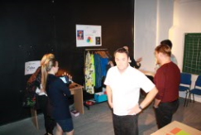
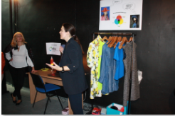
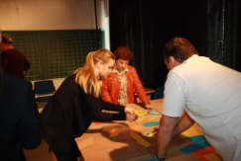
Key example
Create a new solution space. The key (help) for that is synthesis. But you need to find the INSTRUCTION FOR TASK NR 7. Look at man and woman!!!

Slide 11
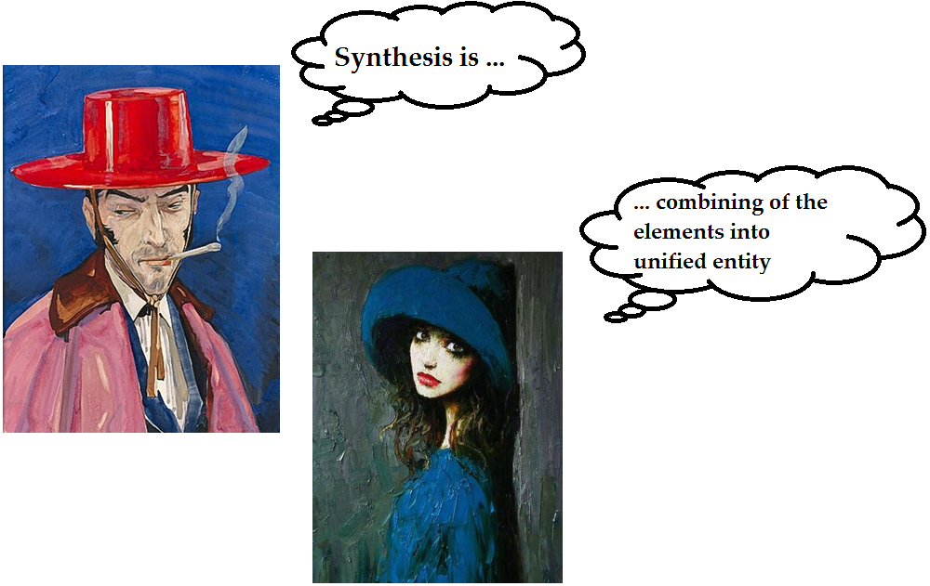
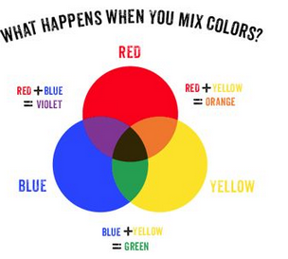

Slide 12
ICCE workshop for students
EKA 1st workshop
Dates: November 23, December 7, 2017
Students: 1st year and 2nd year students (29) - ENG
Study course: “Organisation of the company’s business”
EKA 2nd workshop:
Dates: March – April, 2018
Students: 3nd year students - LAT
Study course: “Management”

Slide 13
ICCE workshop programme

Slide 14
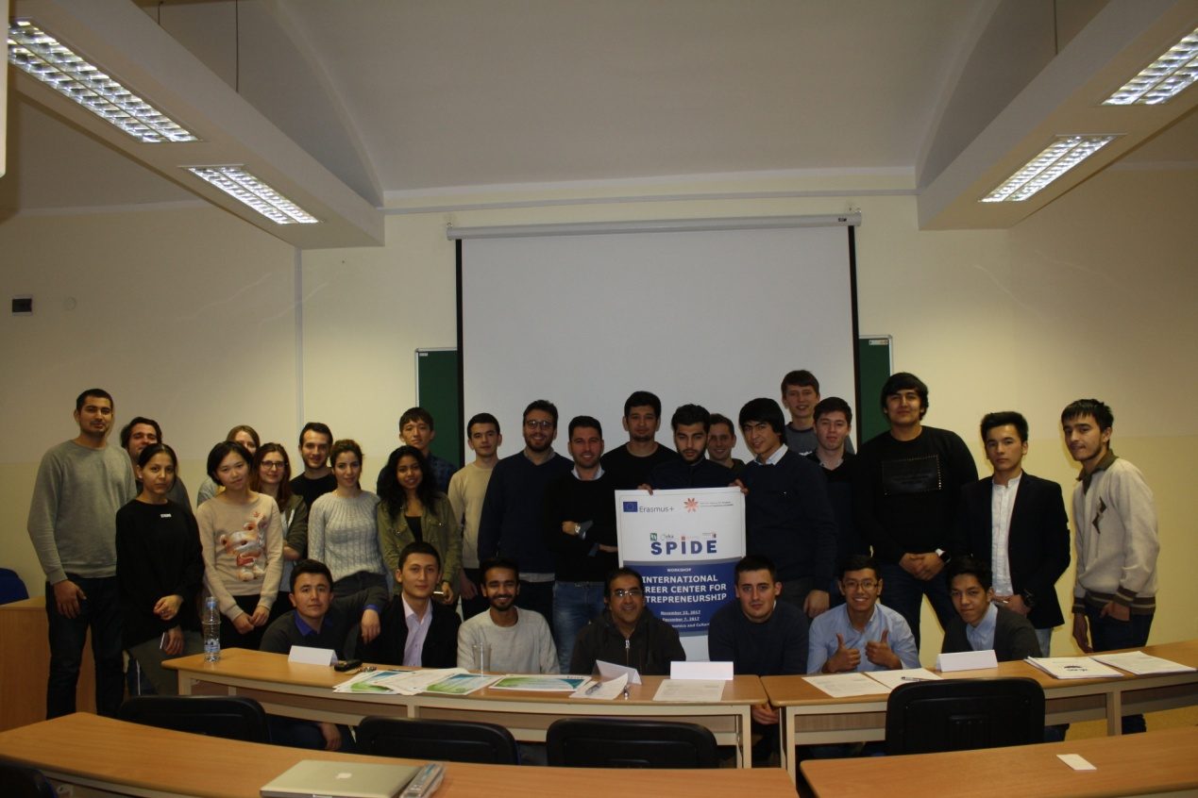
ICCE workshop: feedback
Managed:
Idea generation
Oral presentation
English speaking
Failed:
Team work
Marketing research
Financial analysis
Business plan

Slide 15
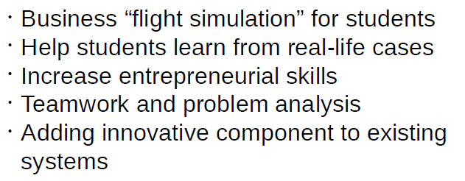
Business Simulation Software (BSS)
BSS is an innovative IT solution providing practical teaching and learning experience to students

Slide 16
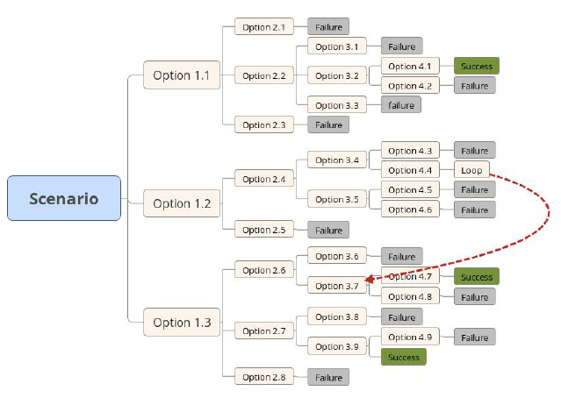
BSS scenarios

Slide 17
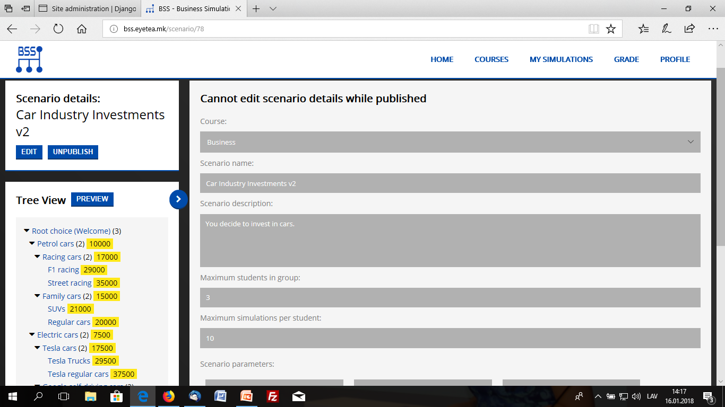
BSS interface

Slide 18
Thank you for your attention!

